Slide 1
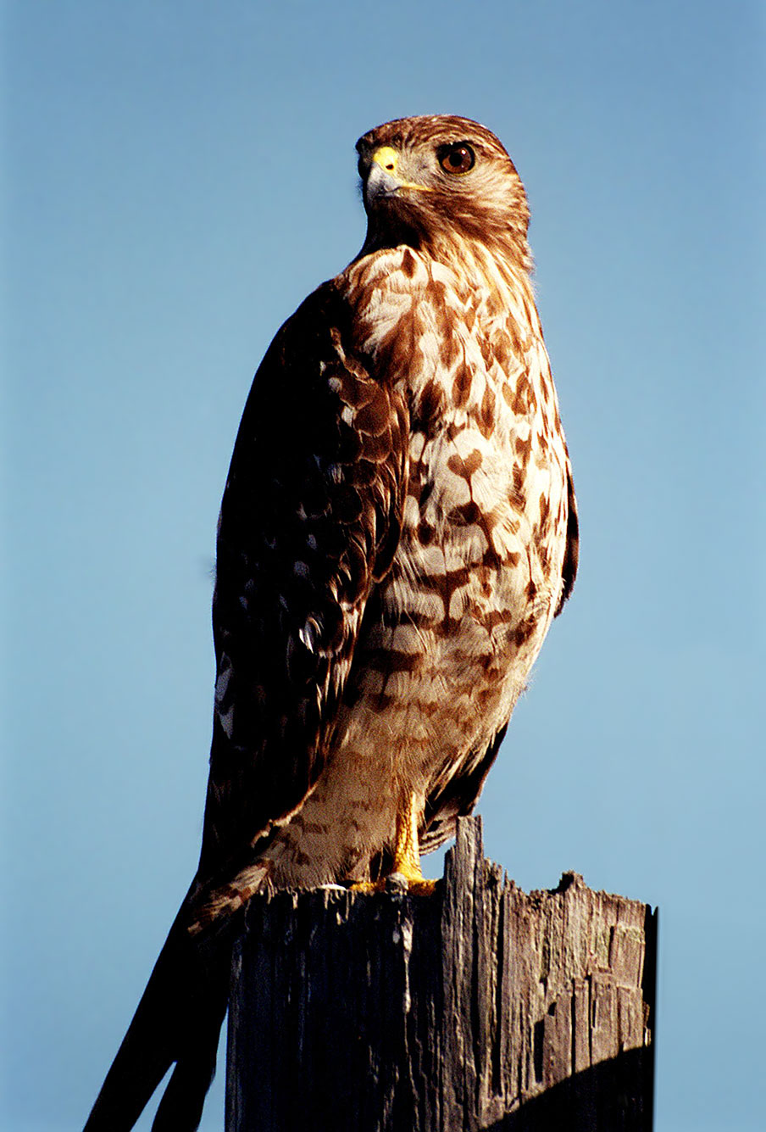
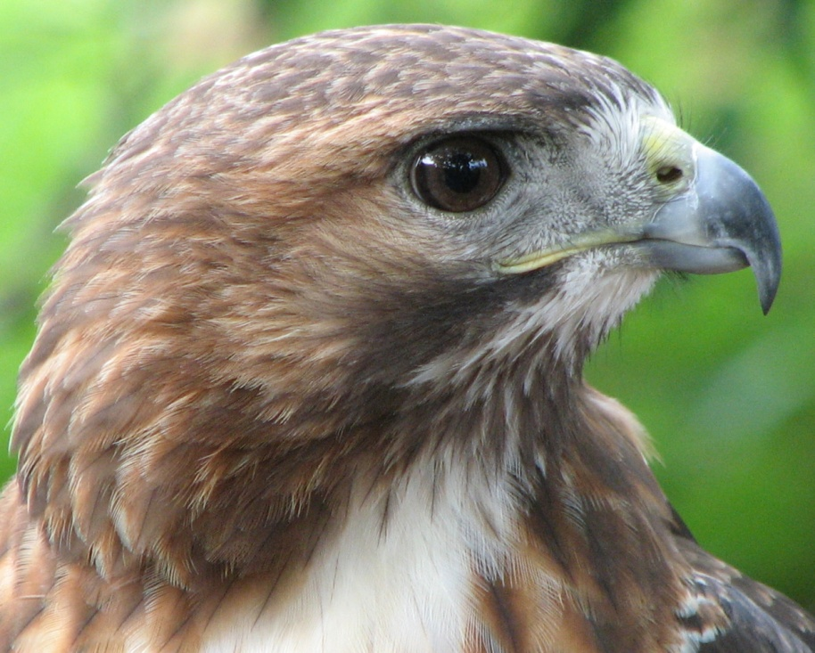
Red Tailed Hawks!
My Genius Hour Project
By: Angie Memmi

Slide 2
Starting Off Simple
Imagine you are taking a walk outside and it’s a frigid, snowy day. You know most birds have migrated for the winter, but something catches your attention. High up in a tree, there is a huge empty nest.
Suddenly, you hear a raspy scream and see an enormous bird up in the sky. You think it’s an eagle or a falcon, but it doesn’t look like either of those birds.
Then, you realize it’s a RED TAILED HAWK!
Red Tailed Hawks are the most common species of hawk in North America. That’s because they can adapt to any habitat — including, fields and pastures, parks, broken woodland, desert, scrublands, grasslands, roadsides, and tropical rainforests.
Obviously, their IUCN (International Union for Conservation of Nature) conservation status is “least concern.”

Slide 3
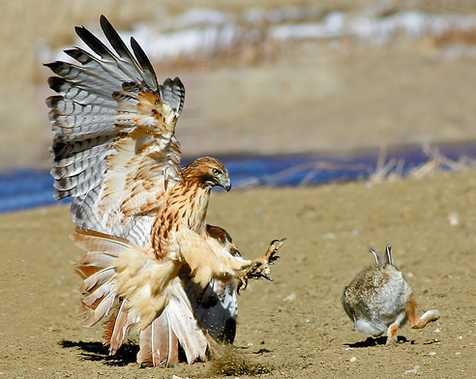
What’s for Dinner?
The reason red-tailed hawks can adapt anywhere is because their usual prey can live in numerous habitats.
If you’re a small mammal or a small bird, the Red Tailed Hawk wants you for dinner.
Rabbits
Voles
Mice
Wood rats
Snowshoe hares
Ground squirrels
Bon Appetite!
Pheasants
Bobwhite
Starlings
Blackbirds
Snakes
Carrion beetles
Red Tailed Hawks will usually sit on a high perch and just listen or watch. They have excellent hearing and eyesight. They will quickly swoop down and snatch up their prey.
They use their sharp, curved talons for getting their victim. When they are catching another bird, they will either wait for the bird to land on the ground, or try to capture a bird in flight. They are usually seen hunting in pairs. If they’re desperate, they might do something called pirating.

Slide 4
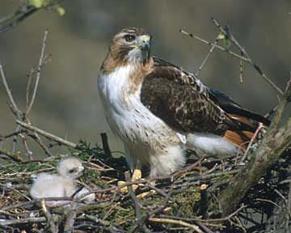
The Nest
Nesting is simple:
Red tailed Hawks mate for life
so they build a nest together.
Made of dry sticks, bark strips,
fresh foliage, and dry vegetation.
Is completed in about 4-7 days.
Where it is:
Crowns of tall trees
Cliff ledge
Human Structures
Window ledges
Billboards
Anywhere with they have a vast view of the area.

Slide 5
INTERESTING FACTS
Here are some cool facts!
The oldest known Red Tailed Hawk is 28 years, old 10 months (in wild)
Average life span is 10-15 years old (in wild)
Red-tailed Hawks are often seen hunting as a pair, guarding opposite sides of the same tree to catch tree squirrels. Now that’s teamwork!
You’re unlikely to see this bird in your backyard (unless you have a really big one). Red-tailed Hawks eat mostly mammals, so they’re less likely to visit a backyard bird feeder. It’s very rare for a Red-tailed Hawk to go after dogs or cats. Thank goodness!
A Red-tailed Hawk named Pale Male is one of the most famous residents of New York City (and shares an apartment building with actor, Woody Allen). There are many websites about him, including his own Wikipedia page and a page that includes a PBS documentary about him.

Slide 6
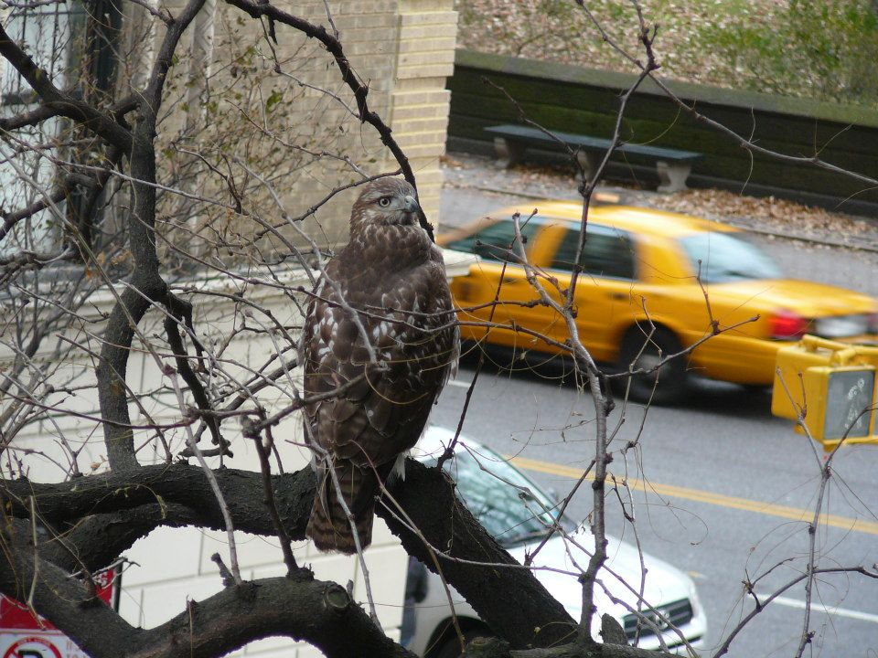
MORE INTERESTING FACTS
Have you ever heard this sound before?
Say Hi to Pale Male!

