Slide 1
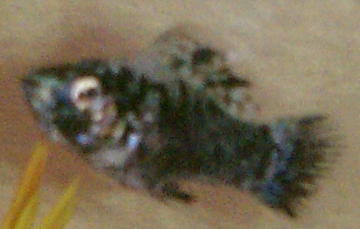
MY HABITATTITUDE FOR DALLAS
A Power Point from the Fish’s Prospective
By Cassy Maart

Slide 2
Facts About Me
1. I’m a male Dalmatian molly. My owner could tell I was a male because I have a line-shaped fin along my stomach.
2. I’m white with black spots; just like a Dalmatian puppy.
3. My scientific name is “Poecilia sphenops.”

Slide 3
My Fishbowl
My home is 6 ½ in. high, 6 in. long and 4 in. wide.
There is a spread of pebbles: yellow, green, clear and blue perfectly laying at the bottom.
I also get to swim around a spiky-looking orange & yellow plant rooted in the pebbles.
My specially treated water goes almost all the way to the top of my home.
My bowl sits in a cage because of the sinister cats that constantly lurk around this space!

Slide 4
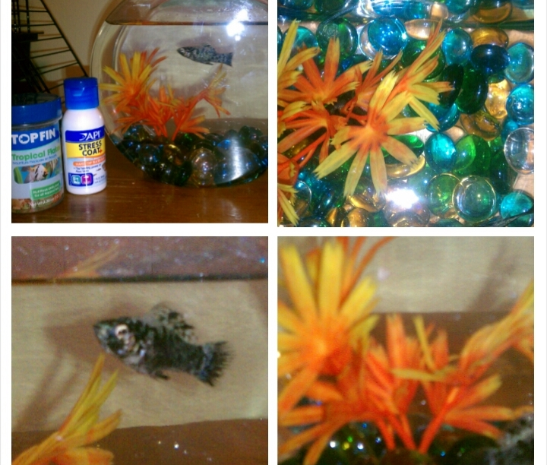
Check out my home!
Top left- a picture with my food and the water cleaner!
Top right- My cool pebbles!
Low left- The star of
this project; ME!!!!!!
Low right- My very adored plant decoration!
I’m love’n all this attention!☺

Slide 5
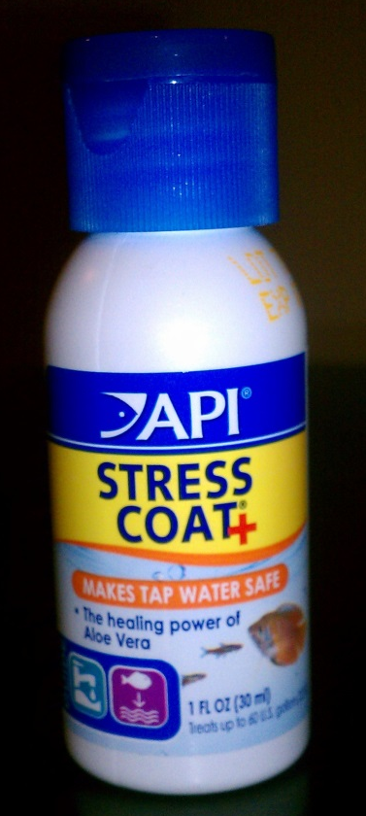
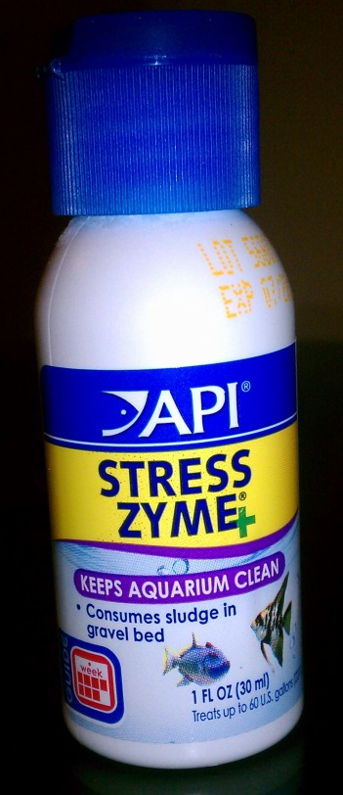
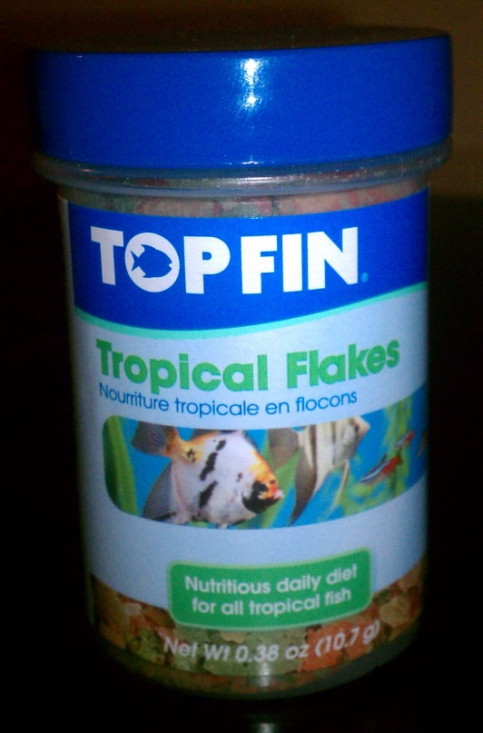
Health Things
Stress zyme keeps my home squeaky clean! You can only put it in when you’re changing my water.
This is my food. It’s called flake food. It has fish meal and wheat flour in it.
Stress coat makes tap water safe for us fish to swim in.

Slide 6
Open Note From Cassy
I chose this passion project because I adore animals. I wanted to try taking care of a fish. It has worked great so far. Dallas is a happy, healthy and little fish. I want it to stay that way.

Slide 7
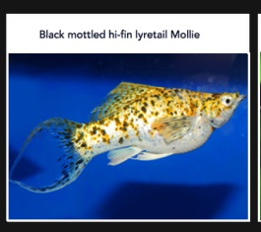

Other Types of Molly Fish

