Slide 1
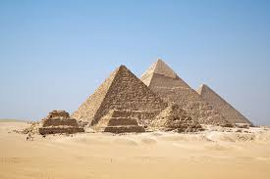
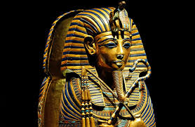
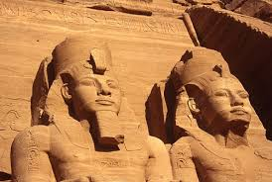
Egyptian Gods & Goddesses
By Kole Kramer

Slide 2
King Gods
These gods & goddess are very important in the ruling of the people & the gods

Slide 3
Ra
Ra was the sun god in Egyptian Mythology. He was also known as the father of the gods. He had the duty of sailing over the earth each day, giving light & warmth. During the night, Ra would fly through the Daut, the Egyptian underworld. He was also a king-like god since he was the gods father.

Slide 4
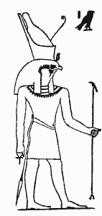
Horus
It was some times said that each pharaoh was an embodiment of Horus himself. He was the god of war strategy & kings. He kept the gods in check once it was decided that he would be king instead of Set. While waging war against his uncle, Set, the gods noticed his power, & honored him as a warrior.

Slide 5
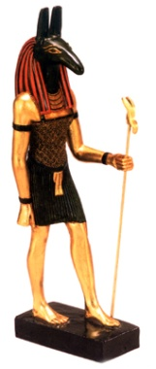
Set
Set was the Egyptian god of the desert, thunderstorms, & arid heat. He was always hot-tempered, & when his brother Osiris took the throne, he was furious. So he murdered Osiris out of jealousy. Then, when it was said that Horus, Osiris’s son should take over, Set planned to get rid of him. However, Horus had expected this, so he turned it into a long lasting argument. Also, he stationed guards to keep Set away. The final straw was when Neith showed everyone who the king would be. Set, not trusted by the gods & no longer able to take the throne, isolated himself from further harm.

Slide 6
Isis
Isis was the goddess of magic & considered the mother of the pharaohs. She was the wife of Osiris & the mother of Horus. She trained him to become the rightful king that would avenge her husband’s death. All people loved her because she was good & kind, & gave them a rightful leader, their pharaoh.

Slide 7
Gods of the Underworld
The gods & goddess that reside in the Duat, The Egyptian Underworld

Slide 8
Osiris
Originally, Osiris was the god of the earth. He was placed King because of his vast knowledge of agriculture & farming. One day, he was murdered by his brother, Set, out of jealousy. Horus, Osiris’s son, was placed king, & Osiris was made ruler of the Daut. He decided where the dead went. If they were good-hearted, they were sent to live in his halls. But if they were cruel, they were eaten by Ammit The Devourer.

Slide 9
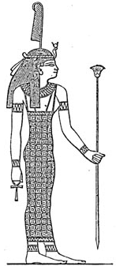
Ma’at
Ma’at is the goddess of order, truth, & law. She was said to punish any pharaoh (king) who did not follow Egyptian law. She helped Osiris & Thoth with the judging of the dead. The feather of Ma’at ( the one pictured on her head) is a very important feather. It stood for truth, so it used to weigh a heart. If the heart weighed more, the heart was a bad one. If it weighed less, the owner of the heart was good.

Slide 10
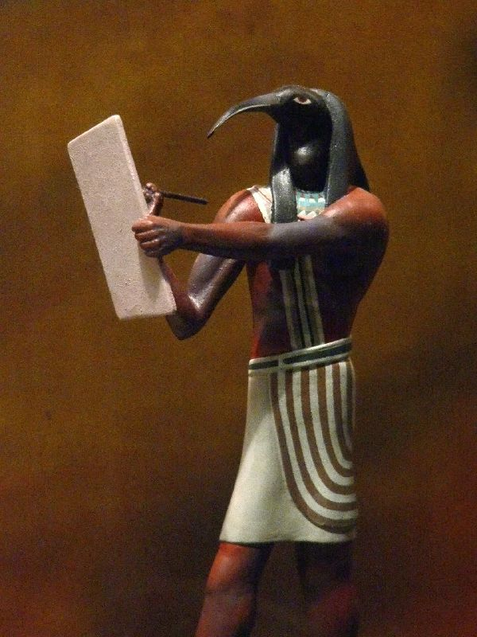
Thoth
Thoth was the god of wisdom & the moon. He was a peaceful god & his main role was to help with the judging of the dead. He did this with Ma’at, his wife. The Book of Thoth, written by Thoth himself, was a book about the secrets of the gods & the Daut. He was said to be the one who taught the people how to read & write.

Slide 11
Miscellaneous Gods
These gods are very important, but don’t belong in the above categories.

Slide 12
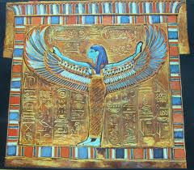
Nut
Nut was the goddess of the entire sky. She was in love with Geb, the god of the ground. But her father, Shu (the god of air), separated her from Geb.

Slide 13
Neith
Neith was the goddess of war, & later, weaving. She was respected by all of the other gods, & her wisdom ended the dispute between Set & Horus over who should take the throne of Egypt. Egyptians used her presence to help them in war.

Slide 14
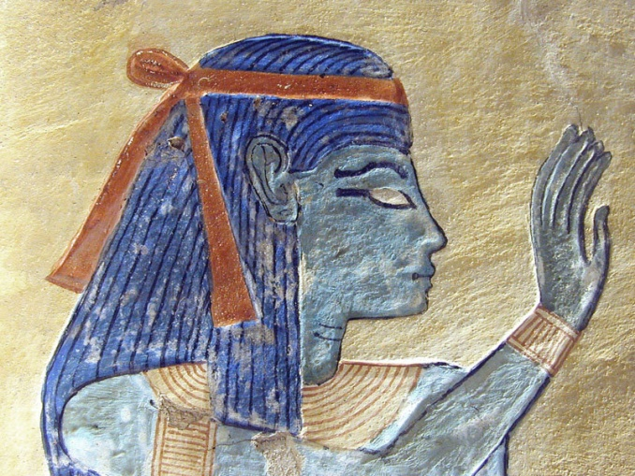
Hathor
Goddess of love & fertility, Hathor is one of the few calm unwarlike goddesses, like Ma’at. Hathor was originally Sekhmet, a very warlike goddess. But when Sekhmet became too bloodthirsty, Ra changed her to Hathor. Horus was her husband.

Slide 15
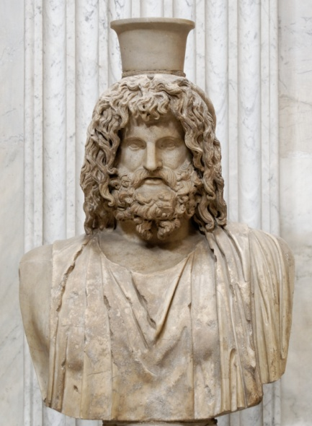
Hapi
Although he may not sound very important, Hapi was sent tons of offerings from the Egyptians. Hapi was the god of the Nile, & he controlled the annual flooding of it that the Egyptians needed to water their crops.

Slide 16
Acknowledgments
For info: www.ablemedia.com; www.crystallinks.com; Rick Riodran’s: The Serpent’s Shadow.
For pictures: www.flickr.com; www.wikipedea.com.

